Slide 1

CEIS110
DeVry University
Introduction to Programming
Larkin, Alisha
July 2022
https://alishalarkin18.wixsite.com/alisha-larkin-devry

Slide 2
Introduction
CEIS110 – Introduction to Programming, students learned about the software development process, coding in python, manipulating data and creating graphical modulars from the weather database.
Learning objectives for CEIS110 includes:
Design, code, and test a working program
Analyze data from a test or experiment
Describe an output of a programming problem
CEIS110 introduces Zybooks, where students can read and achieve advancement in python by studying about sequences and lists, controlled repetition structures, error handling, debugging and making decisions on python.

Slide 3
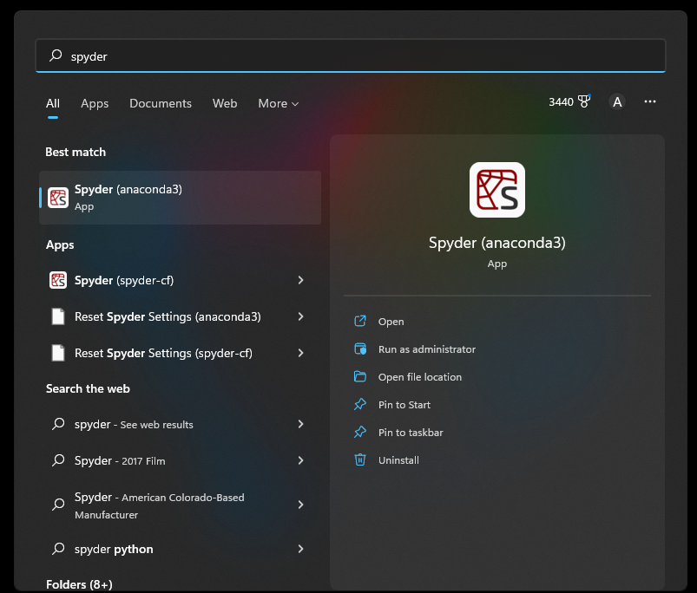
Software Installment
Spyder(anaconda3) is an application used to code and design programs. Here is where I practiced interactive lessons from Zybooks and applied them in Spyder(anaconda3).

Slide 4
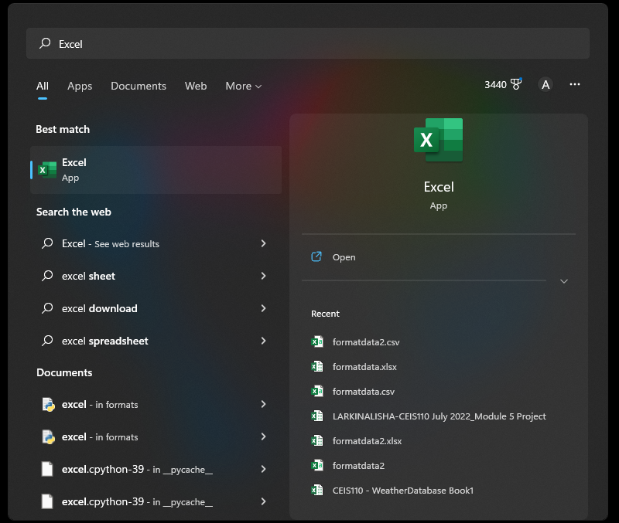
Software Installment
Excel application was used to create a chart with the data from the weather database. The data was then manipulated with the use of python. I then ran the program which created an output file named formatdata.csv and formatdata2.csv.

Slide 5
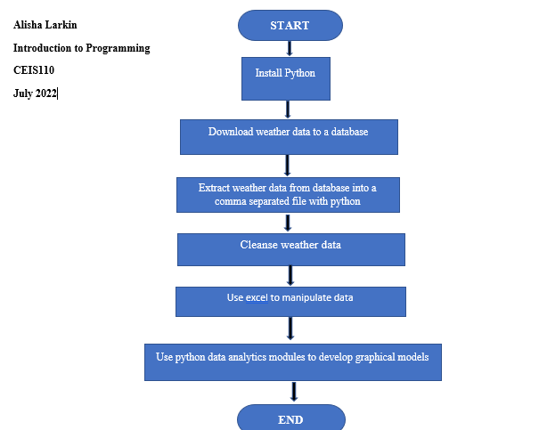
Software Development
Flowchart is used for guidance to provide a structure in the software development process. Flowchart was used to organized my learning objectives for the CEIS110 – Introduction to Programming Course.

Slide 6
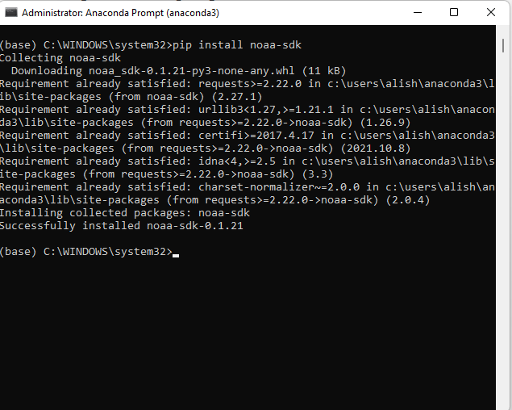
Software Inventory
US Government National Oceanic and Atmospheric Administration (NOAA)
weather data service library was installed
using a python program.

Slide 7
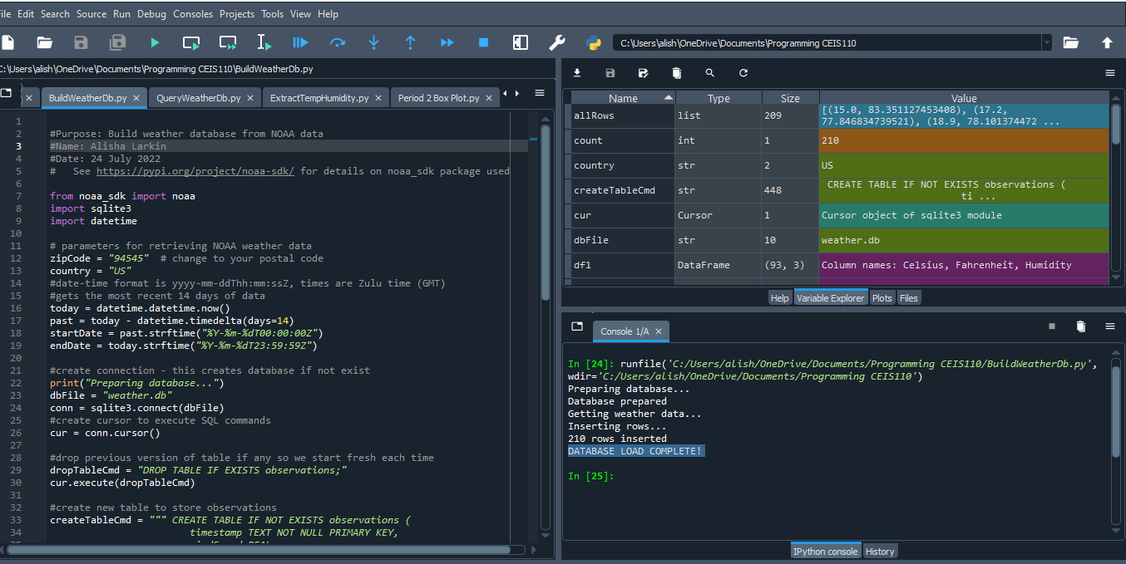
Build WeatherDb.py Code
Application Programming Interface (API) is a cloud-based application used to collect data from a nationwide weather observations. I learned how to build and download code on Python to analyze the US Government National Oceanic and Atmospheric Administration (NOAA) weather database.

Slide 8
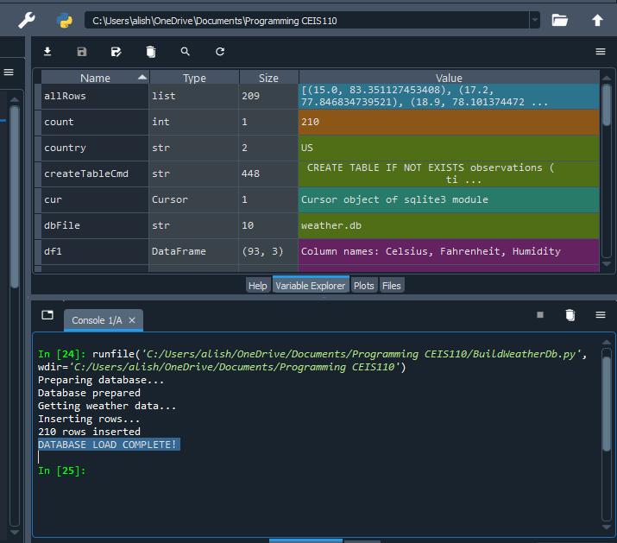
Build WeatherDb.py
Python Console
Spyder(anaconda3) program was used to run Python code to prepare and collect weather data and insert 210 rows of weather data.

Slide 9
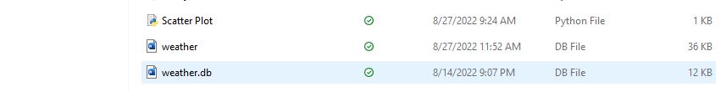
WeatherDb.py
File
WeatherDb.py file was created and saved in
CEIS110 class folder

Slide 10
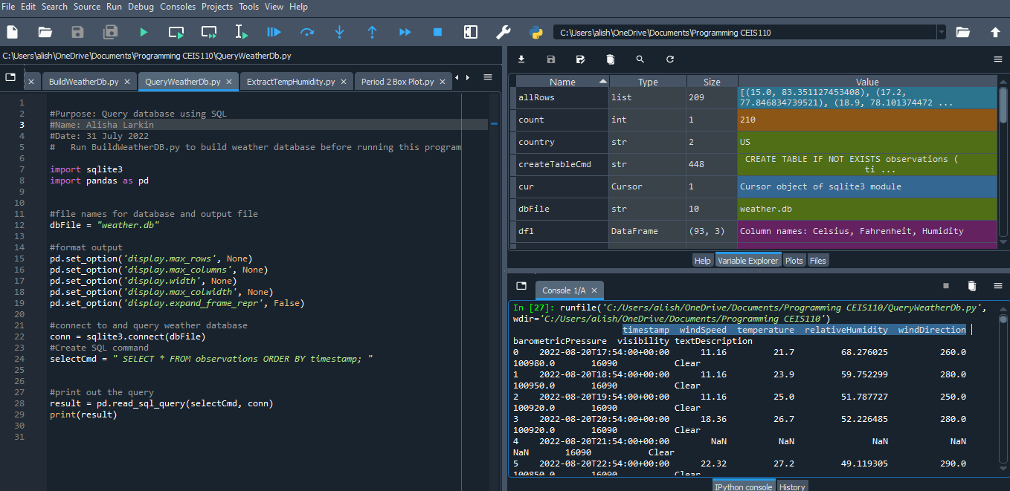
Query WeatherDb.py Code
Weather data was collected and inserted into 210 rows of weather data that included timestamp, windspeed, temperature, humidity, and wind directions.

Slide 11
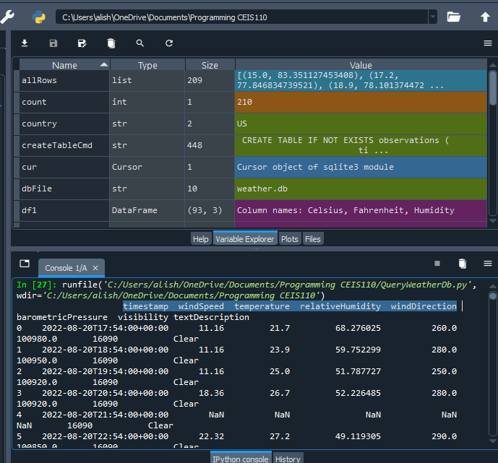
Query WeatherDb.py
Python Console
Program code had to run in python which resulted in weather data in the python console.

Slide 12
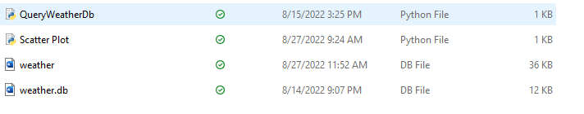
QUERY
WeatherDb.py
File
Query WeatherDb.py file was created and saved in
CEIS110 class folder

Slide 13
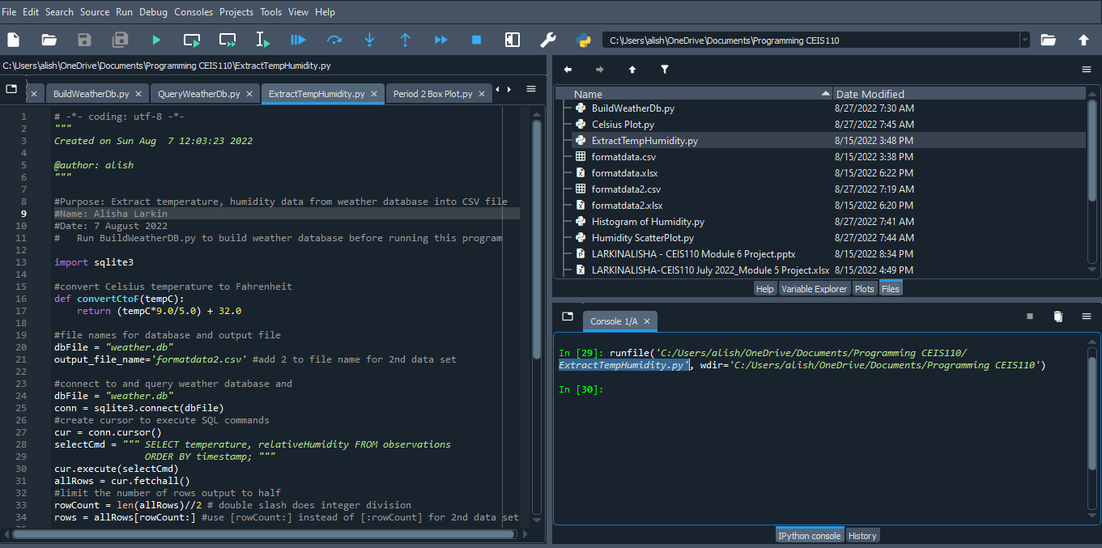
ExtractTemp
Humidity.py
Extract temperature and humidity data from the weather database was collected and transferred into the CSV file.

Slide 14
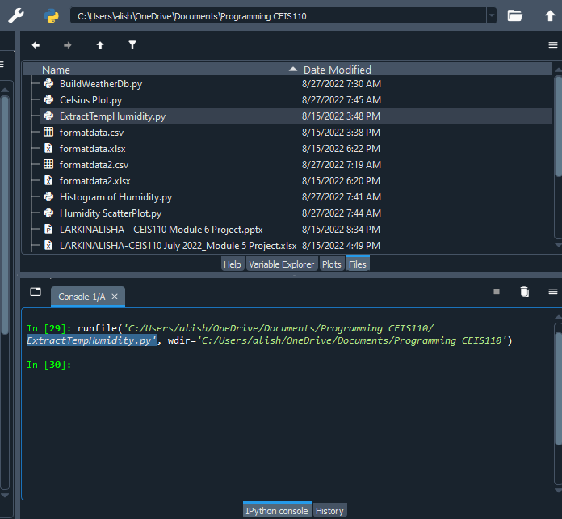
ExtractTemp Humidity.py
Python Console
Extract Temperature Humidity program code was input into python and data was made available on the python console confirming that the formatdata.csv and formatdata2.csv files were created into the CEIS110 class folder.

Slide 15
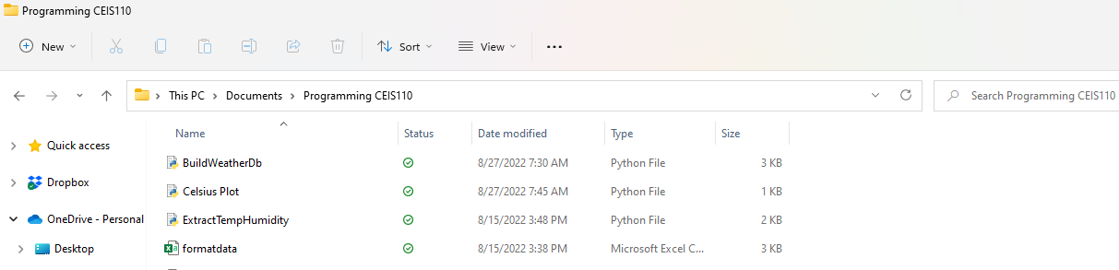
ExtractTemp
Humidity.py
File
ExtractTemp Humidity.py file was created and saved in
CEIS110 class folder

Slide 16
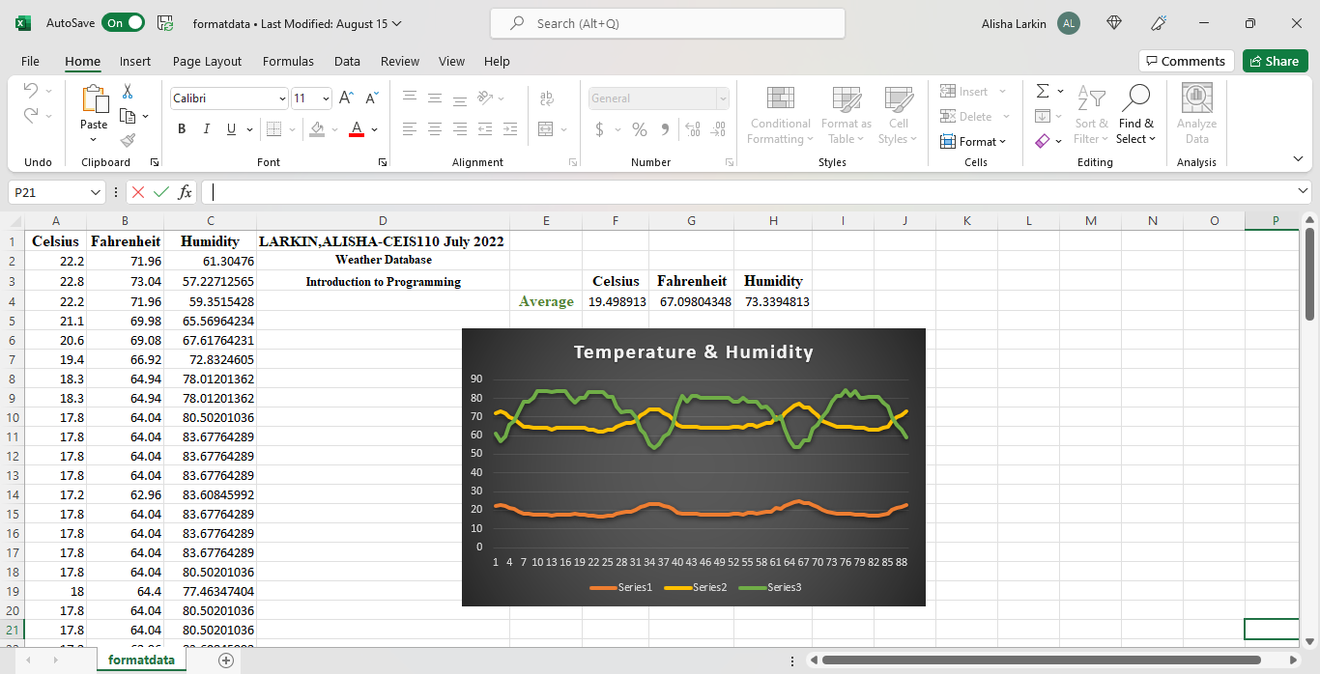
Excel formatdata.csv
Celsius, Fahrenheit, and Humidity weather data created in excel saved as formatdata.csv. Within the excel file is a chart representing comparison of temperature and humidity from the weather database.

Slide 17
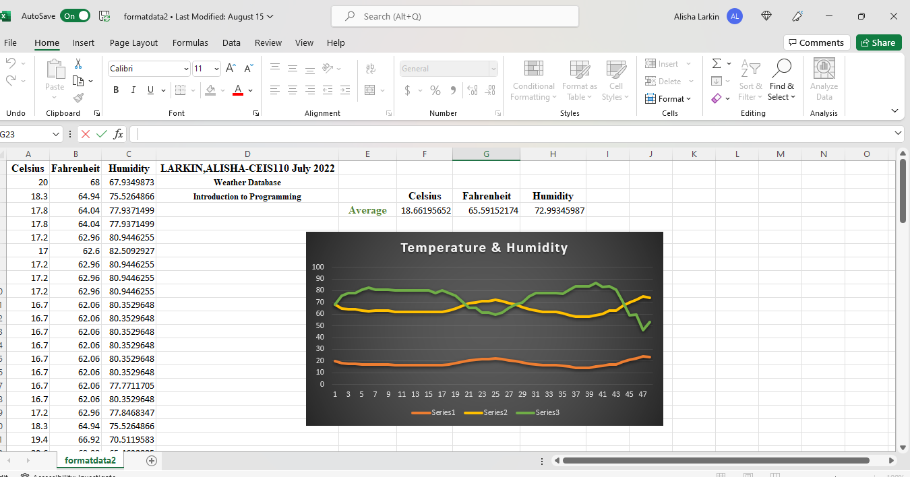
Excel formatdata2.csv
Celsius, Fahrenheit, and Humidity weather data created in excel saved as formatdata2.csv. Within the excel file is a chart representing comparison of temperature and humidity from the weather database.

Slide 18
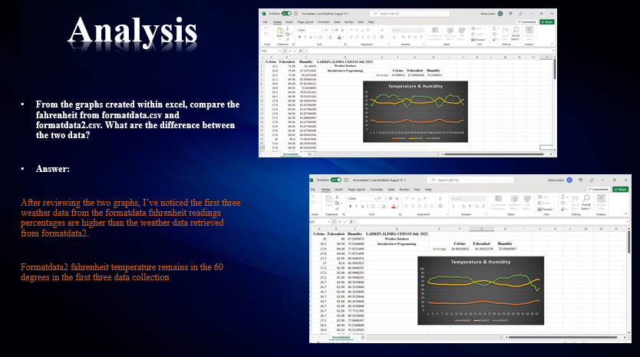

Slide 19
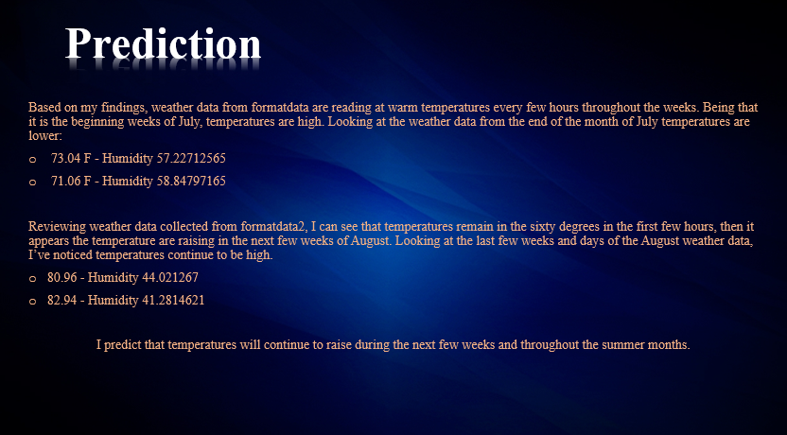

Slide 20
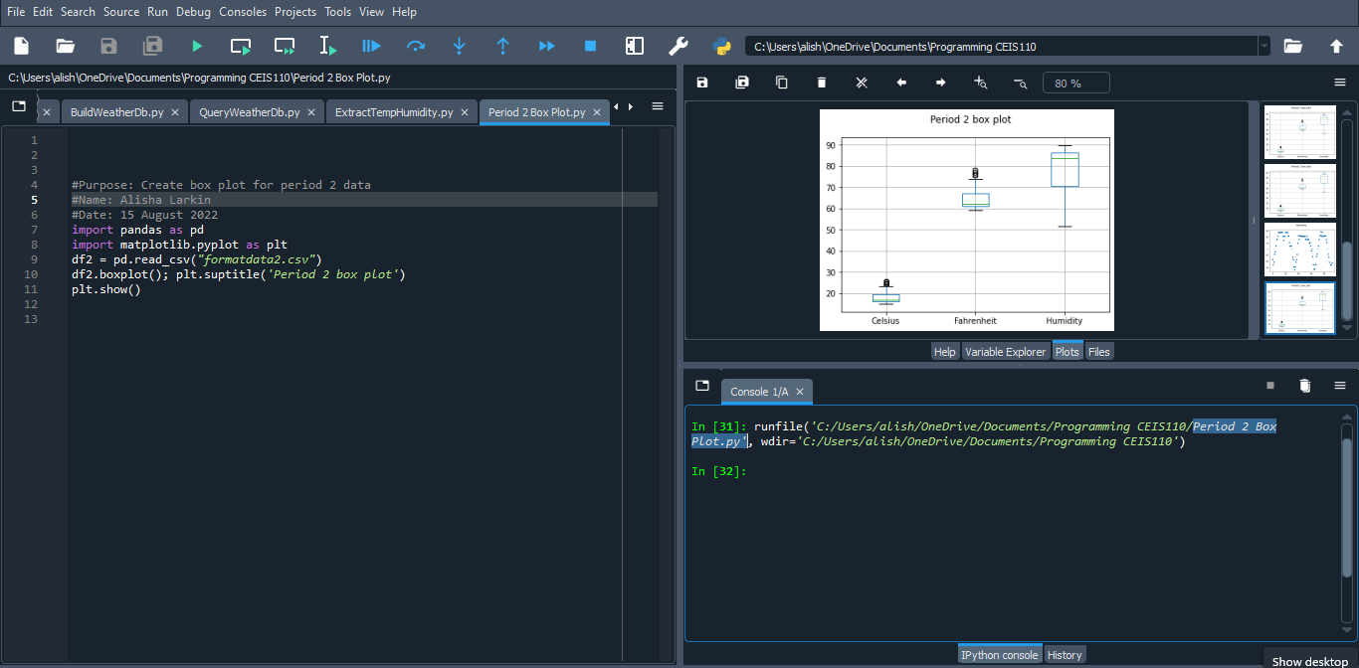
Period 2
Box Plot
Box plot graph was created with the use of
Formatdata.csv and Formatdata2.csv files.

Slide 21
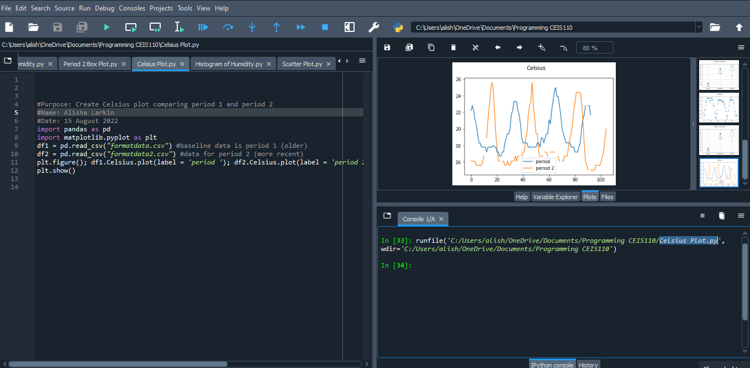
Celsius
Plot
Celsius plot graph was created with the use of Formatdata.csv and Formatdata2.csv files.

Slide 22
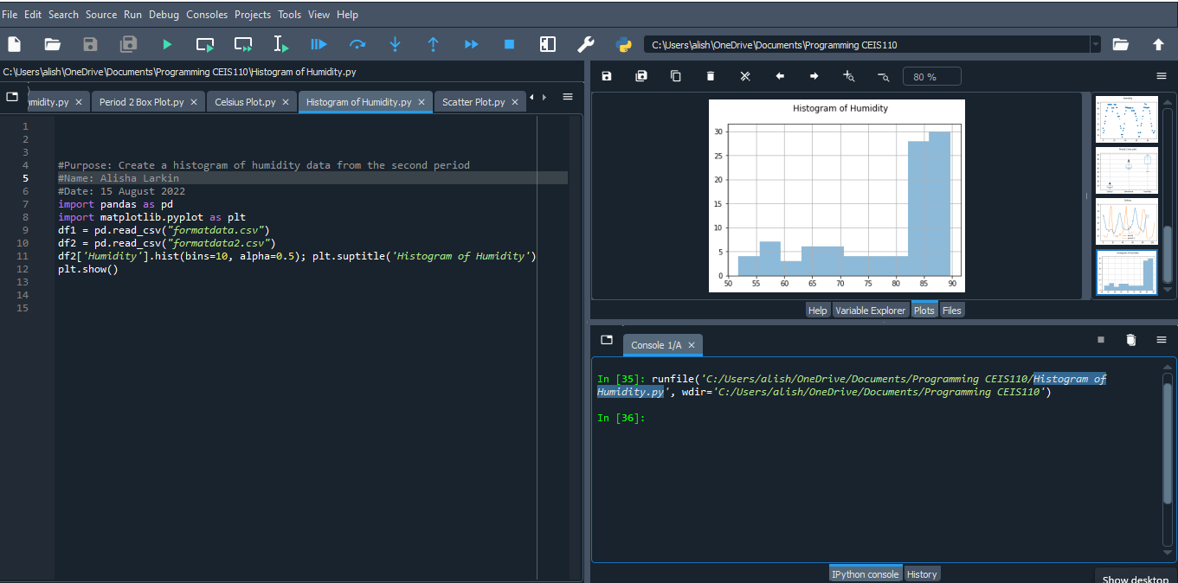
Histogram
Of
Humidity Plot
Histogram of Humidity plot graph was created with the use of Formatdata.csv and Formatdata2.csv files.

Slide 23
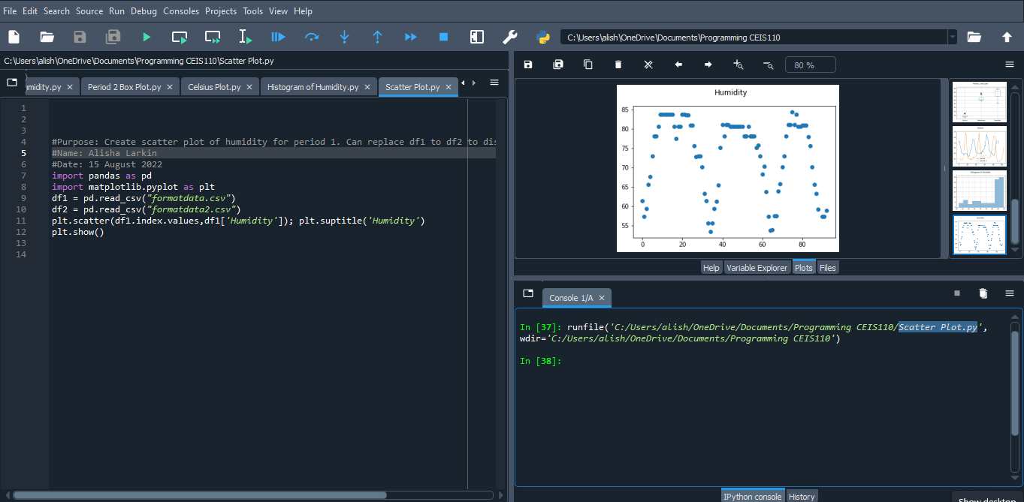
Scatter Plot
Scatter plot graph was created with the use of Formatdata.csv and Formatdata2.csv files.

Slide 24
Challenges
Introduction to Programming (CEIS110) course is a rewarding experience. During my time in this course, I faced some challenges which includes time management and syntax errors. Checking my announcements daily helped me stay up to date on assignments due and changes to applications. Weekly Live Sessions recordings and interactive activities provided abundance of information to help me understand and complete assignments. Schedule faculty huddles and tutoring was a useful tool to receive live help from programming experts regarding syntax errors on Spyder(anaconda3), an application used to code and design programs.
---
Alisha T. Larkin
July 2022

Slide 25
Technology Careers
and
Opportunities
Publications (technology research reports) and career resources (advice from expert) are fantastic ways to study and gain the knowledge to be successful in technology careers.
Professional Associations are great to stay current with the latest technology programs, software and career employment from around the world.
IEEE Computer Society
Python Software Foundation
ACM – Association for Computing Machinery

Slide 26
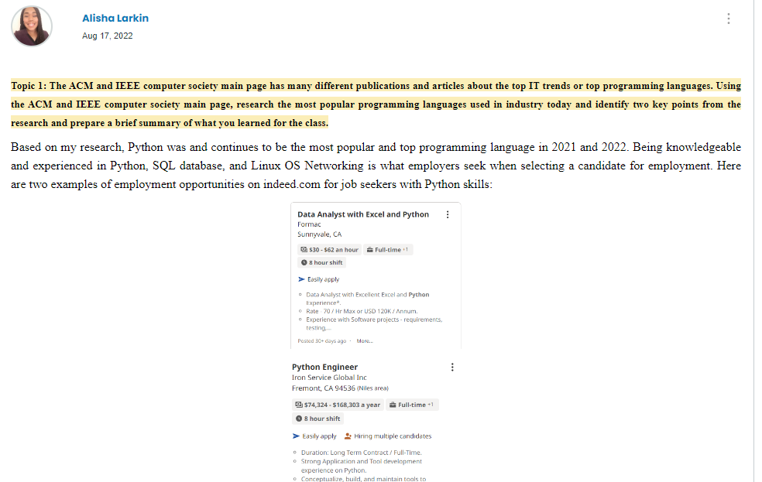

Slide 27
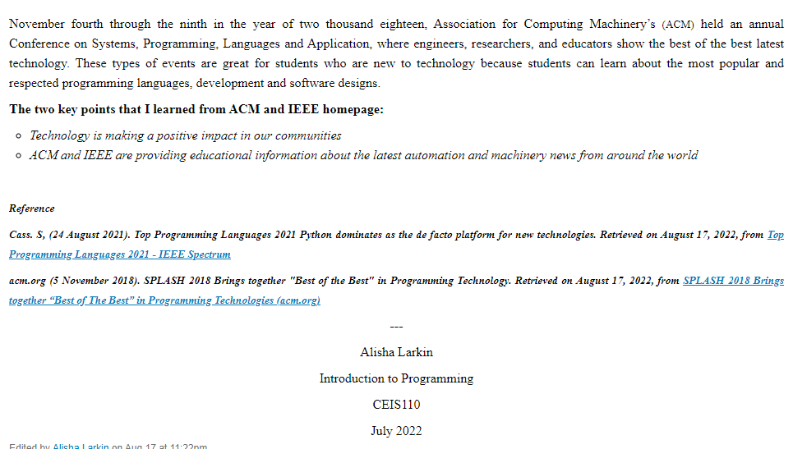

Slide 28
Conclusion
Introduction to Programming (CEIS110) course was one of the best class I have taken at DeVry University. I master how to use infinite loops, for loops, while loops, local and global variables, creating new string and common syntax errors. Retrieving data from the US government National Oceanic and Atmospheric Administration (NOAA) Weather Data service was the highlight of CEIS110. Cloud-based application from the nationwide programming interface (API) was used to create and build weather database to observe and compare collected data pertaining to temperature, humidity, and windspeeds. Creating boxplots and scatter plots was informational and has given me the skills to advance in programming.
Thank you to all the professors that shared their expert knowledge during the CEIS110 course.
---
Alisha T. Larkin
July 2022

Slide 29
Alisha T. Larkin | Introduction to Programming | CEIS110 | July 2022

