Slide 1


NETW191
DeVry University
Fundamental of Information Technology and Networking
Larkin, Alisha
February 25, 2023
https://alishalarkin18.wixsite.com/alisha-larkin-devry

Slide 2
Introduction
NETW191 – Fundamental of Information Technology and Networking, establish the understanding of routing and switching, network troubleshooting, and network security.
Learning objectives for NETW191 includes:
Identify transmission media and their characteristics
Explain reference model numbers
Evaluate security controls and security devices on a network
NETW191 introduces ITPRO.TV, Live Virtual Machines Labs, and Cengage MindTap to help student learn new skills and expand their knowledge for the Fundamental of Information Technology and Networking course with mastery.
This Photo by Unknown Author is licensed under CC BY-SA

Slide 3
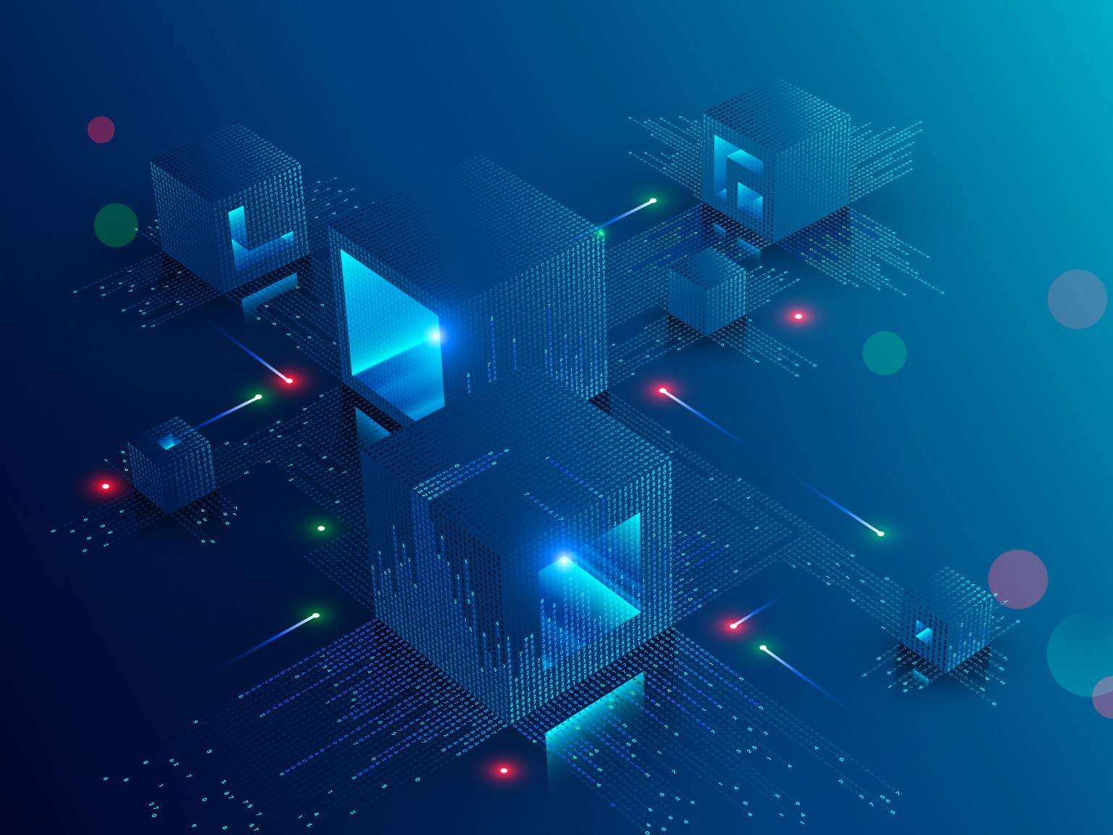
NETW191 Course Project
Module 2
IPv4 Addressing

Slide 4
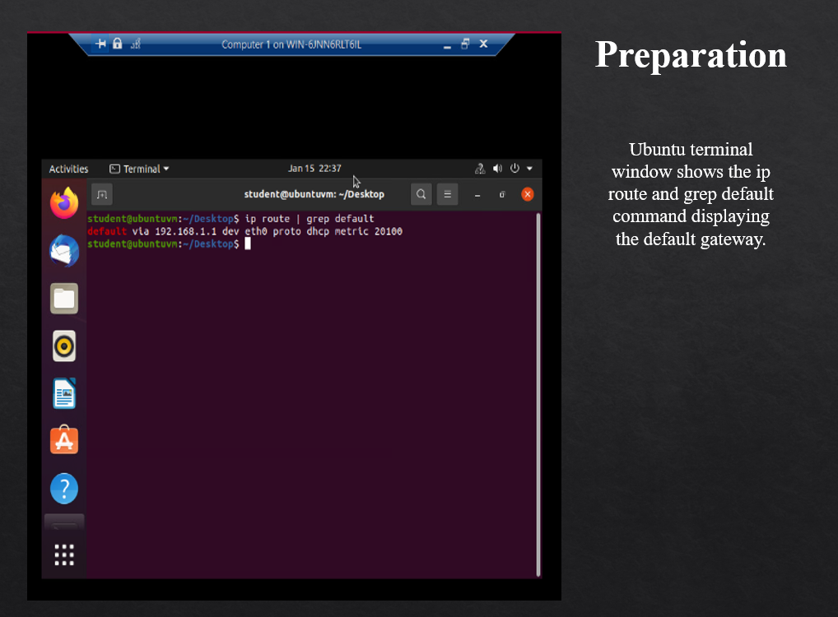

Slide 5
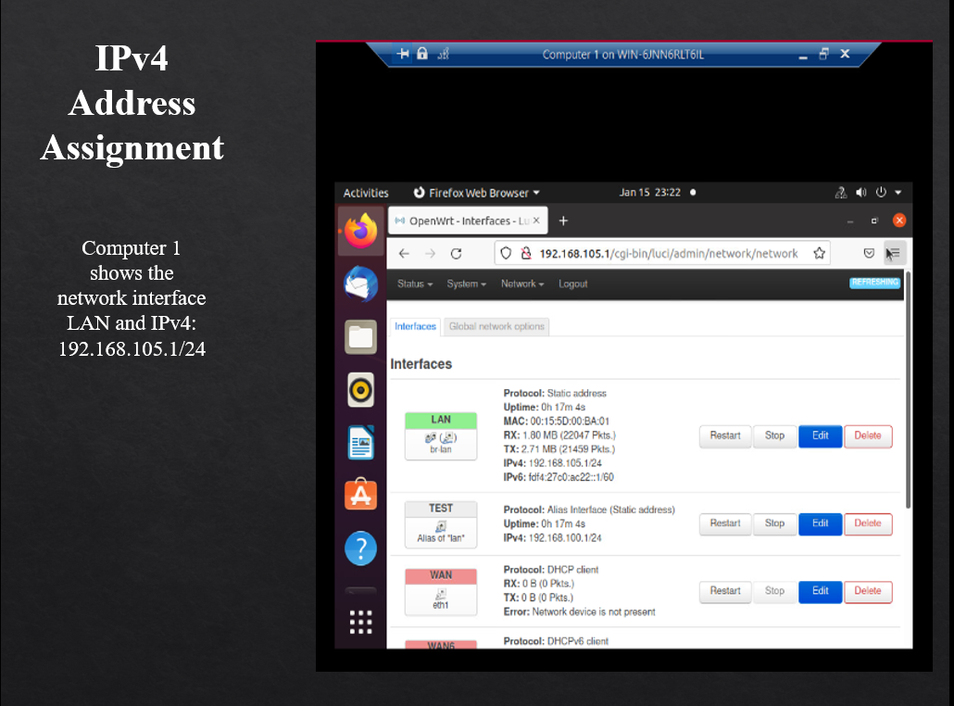

Slide 6
NETW191 Course Project
Module 3
Connectivity Test

Slide 7
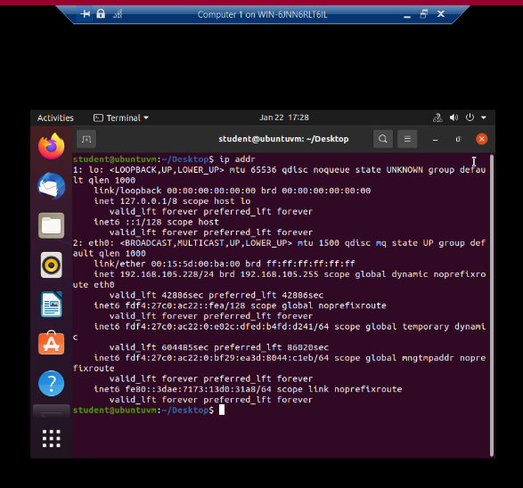
Dynamic IP Address
Terminal show the IPv4 address of the Computer 1 VM.

Slide 8
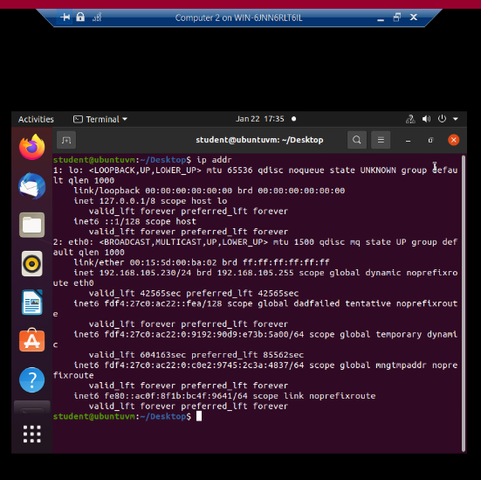
Dynamic IP Address
Ubuntu desktop terminal show the
IPv4 address of the Computer 2 VM.

Slide 9

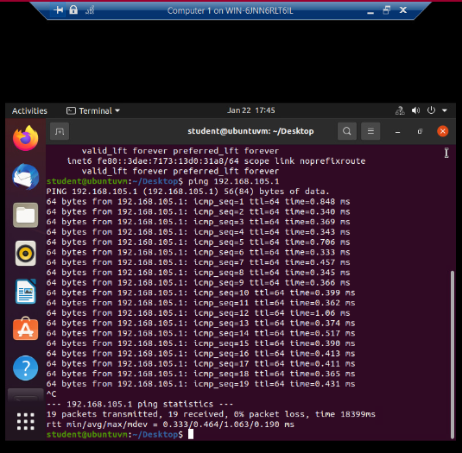
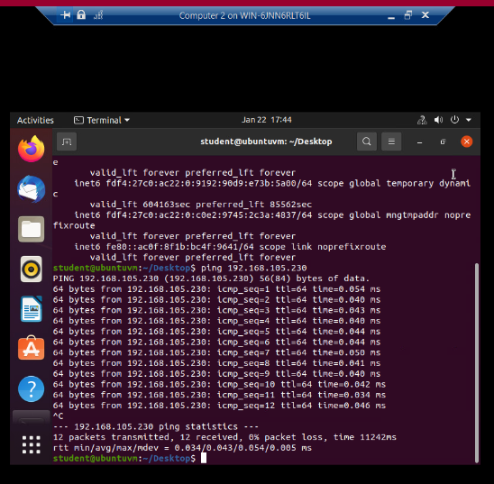
Connectivity Test
Connectivity tests between the Computer 1 VM and the other two devices (i.e., the SOHO Router VM and Computer 2 VM).

Slide 10
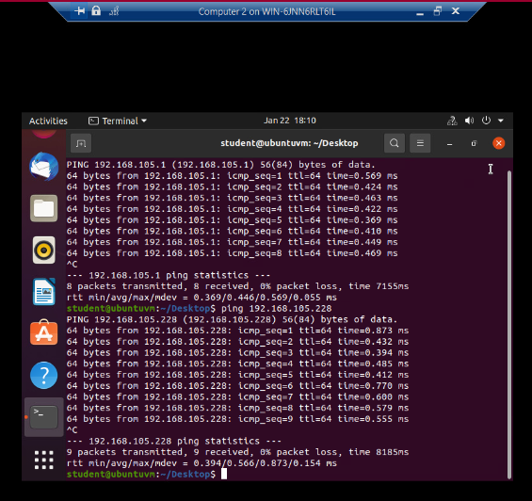
Connectivity Test
Connectivity tests between the Computer 2 VM and the other two devices (i.e., the SOHO Router VM and Computer 1 VM), is displayed on the desktop terminal.

Slide 11
NETW191 Course Project
Module 4
IP Subnetting and Loopback Interfaces

Slide 12
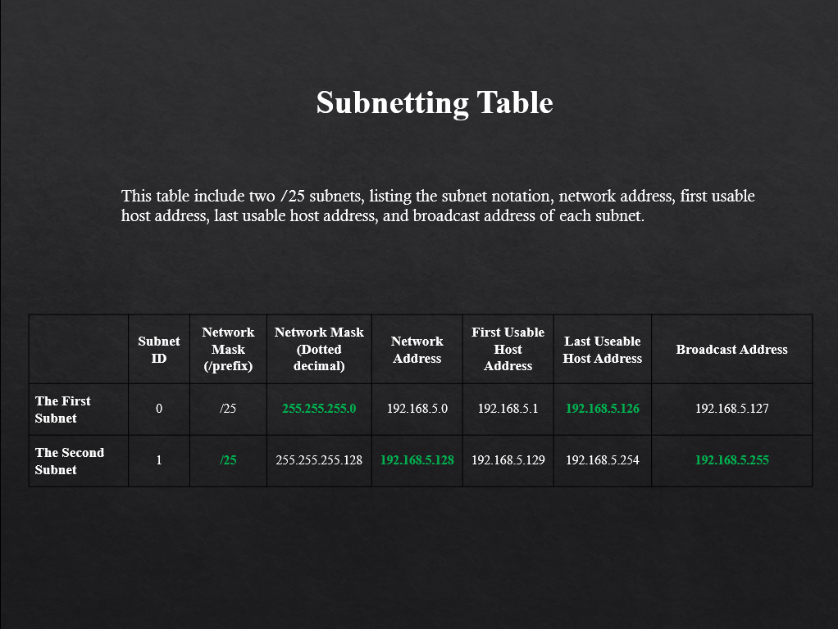

Slide 13
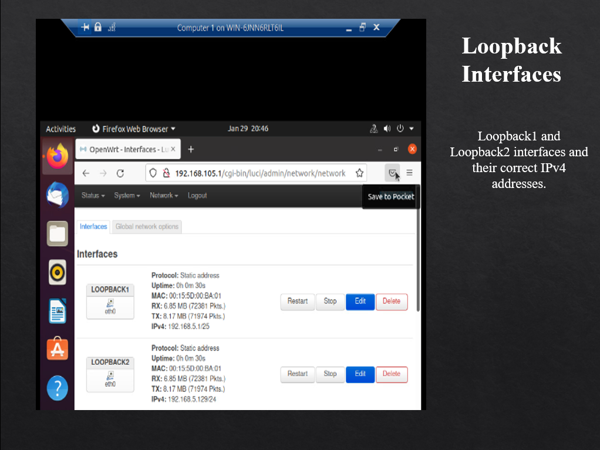

Slide 14
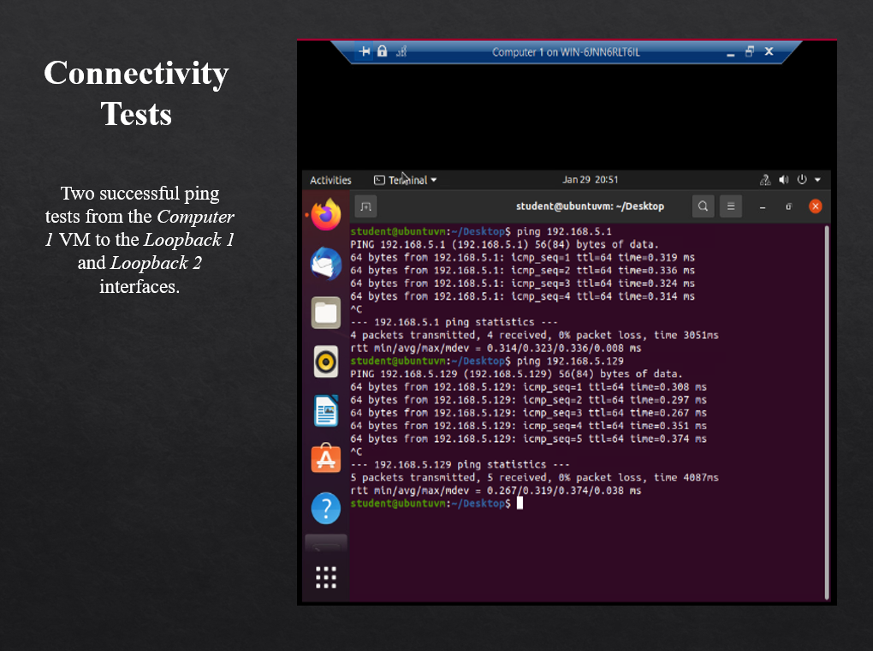

Slide 15
NETW191 Course Project
Module 5
Visio Network Diagram

Slide 16
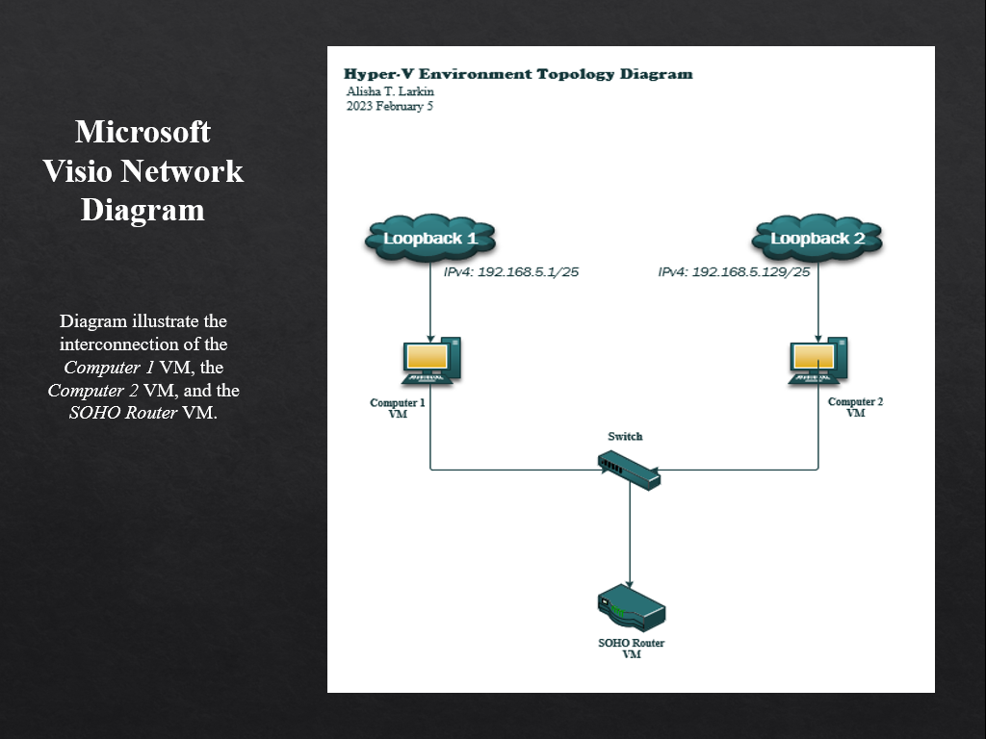

Slide 17
NETW191 Course Project
Module 6
SOHO Wireless Network Security

Slide 18
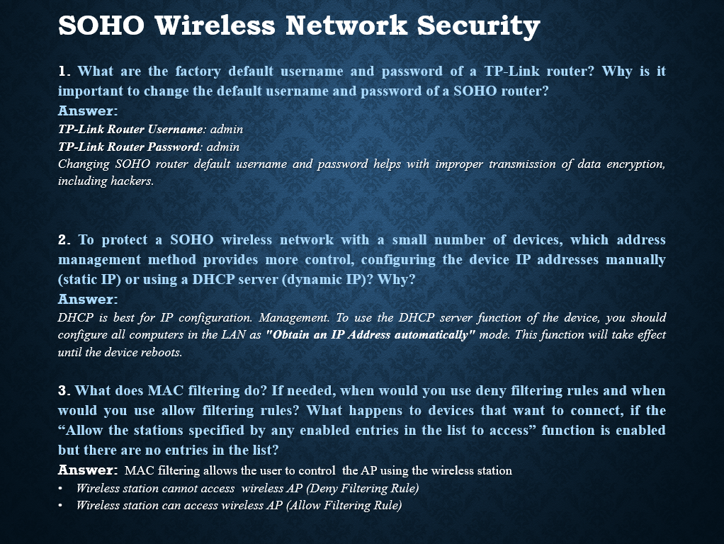

Slide 19
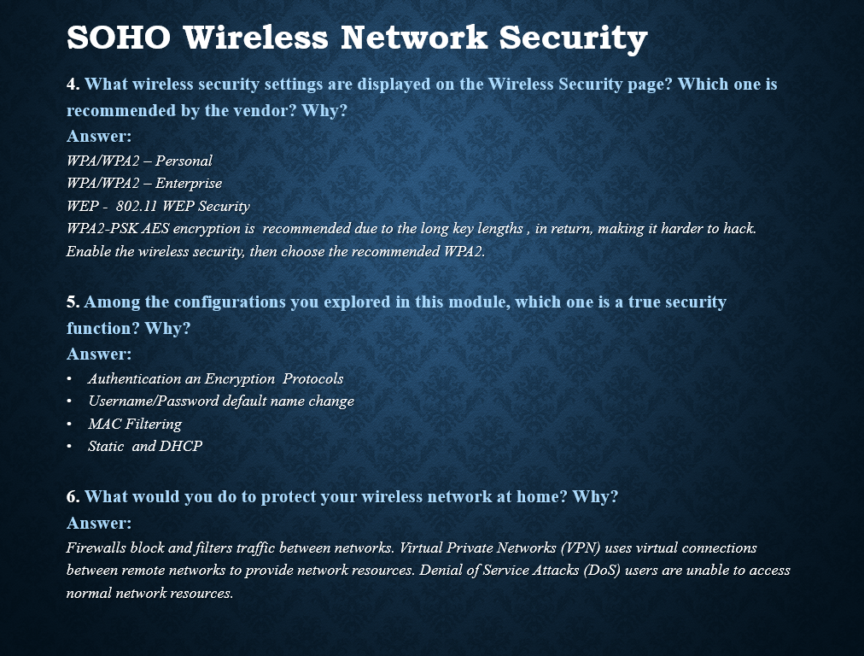

Slide 20
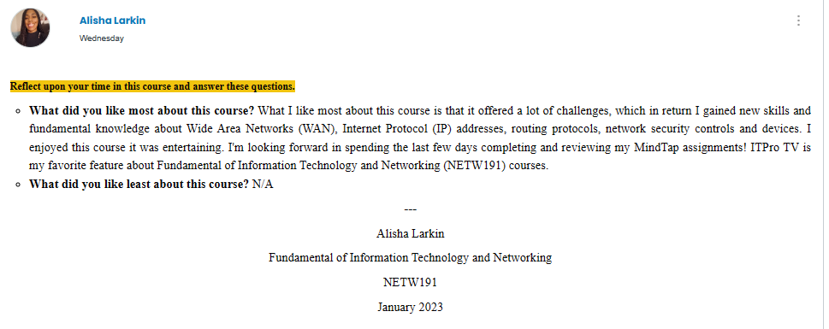
Challenges

Slide 21
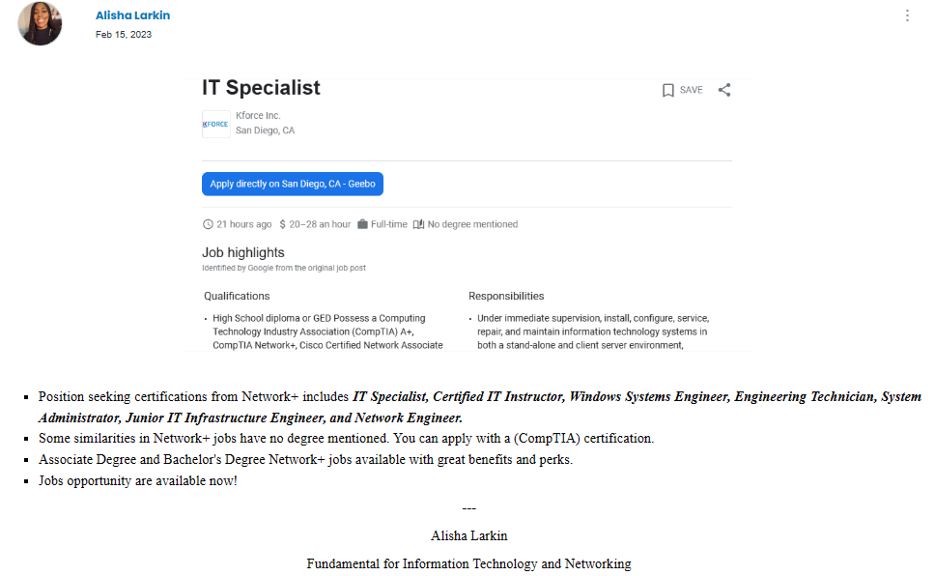
Technology Careers and Opportunity

Slide 22
Conclusion
Fundamental of Information Technology and Networking (NETW191) course was inspiring because of technology careers and opportunity. I reviewed networking careers and certifications and prepared for the Network+ exam which included a CompTIA’s Network+ Certification Practice Exam. ITPRO.TV offered topics that covered network traffic properties, TCP/IP models, cabling solutions, cloud concepts, OSI models, ports and protocols, and IP addressing assignments. Professor Afzal shared his knowledge with students and provided tools to make sure I understood the material given in the course. I enjoyed NETW191.
___
Alisha T. Larkin

Slide 23
Reference
Fundamentals of Information Technology and Networking Live Lectures Week 1-8
West, Andrews, & Dean. (2019). Network+ Guide to Networks, Eighth Edition
What is a Small Office Home Office (SOHO) Network? (2022, November 30). GeeksforGeeks. Retrieved February 25, 2023, from https://www.geeksforgeeks.org/what-is-a-small-office-home-office-soho-network/

Slide 24
Alisha T. Larkin | Fundamental of Information Technology and Networking | NETW191 | February 2023

