Slide 1

NETW211
DeVry University
Fundamentals of Cloud Computing
Larkin, Alisha
April 22, 2023
https://alishalarkin18.wixsite.com/alisha-larkin-devry

Slide 2
Introduction
NETW211 – Fundamentals of Cloud Computing, explore cloud computing and understanding virtualization of cloud computing.
Learning objectives for NETW211 includes:
Produce a network on the cloud platform
Assess cloud-centric access control techniques
Explain virtualization of the networking
NETW211 introduces ITPRO.TV, Live, Virtual Machines Labs, and Cengage MindTap to help student to strengthen their skills to prepare for the job market in technology.

Slide 3
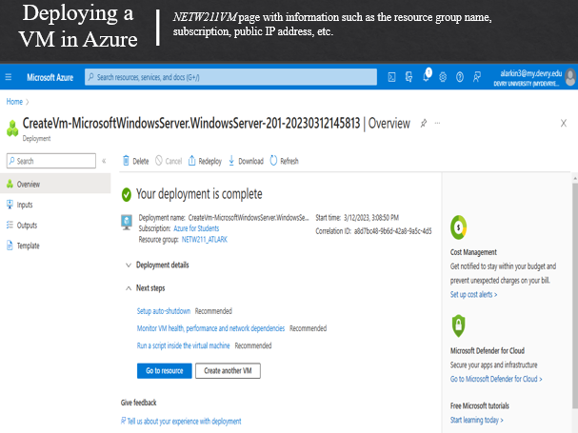

Slide 4
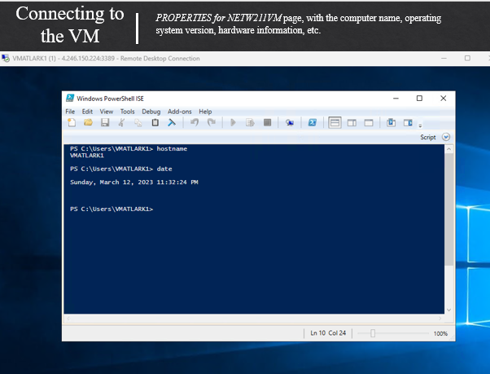

Slide 5
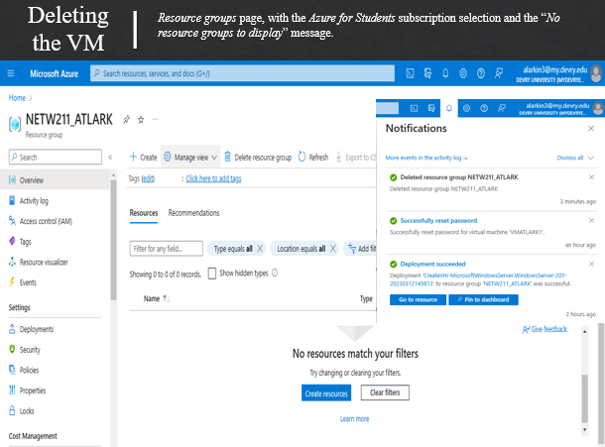

Slide 6
Module 3 Azure VNET and Subnets

Slide 7
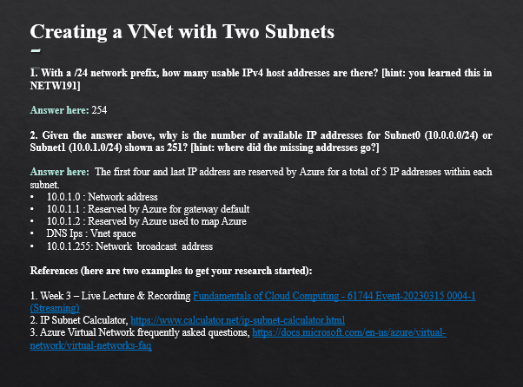

Slide 8
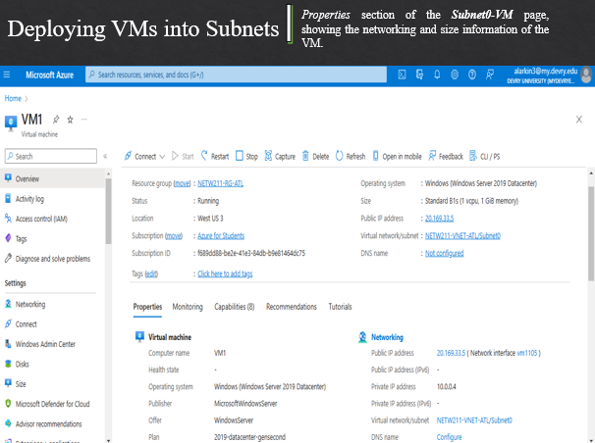

Slide 9
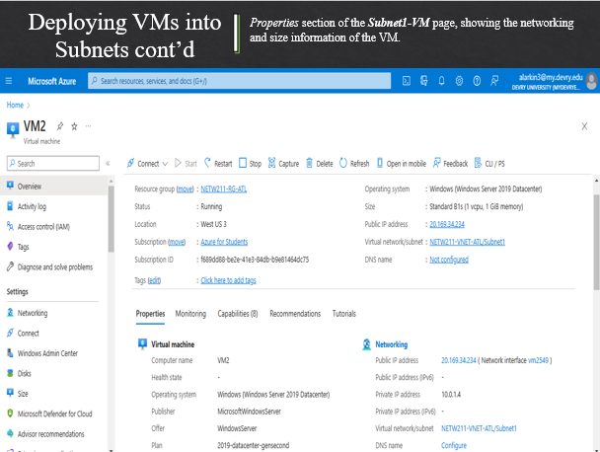

Slide 10
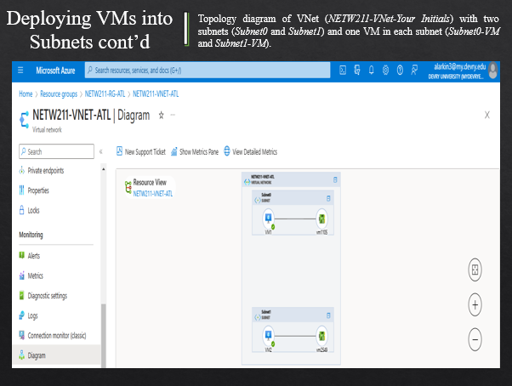

Slide 11
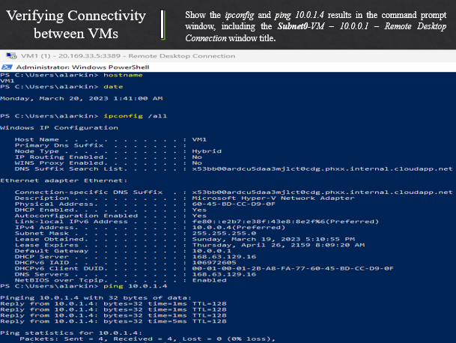

Slide 12
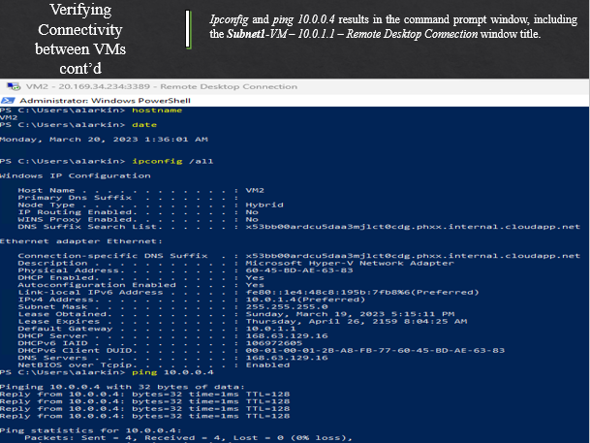

Slide 13
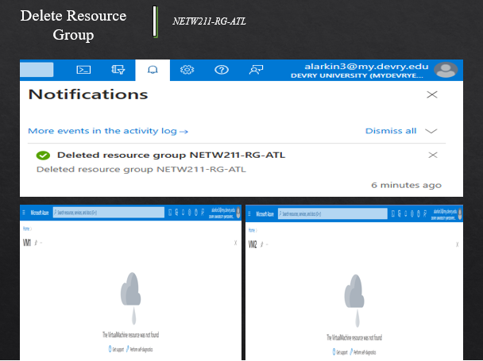

Slide 14
Module 4 Azure VM Security

Slide 15
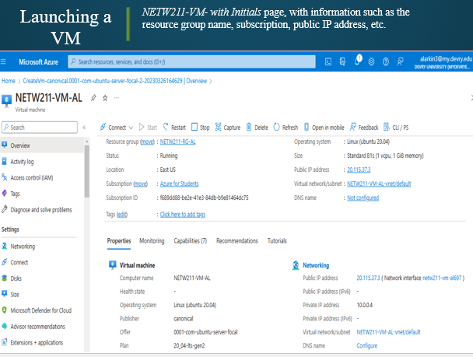

Slide 16
Module 5 Cloud Storage

Slide 17
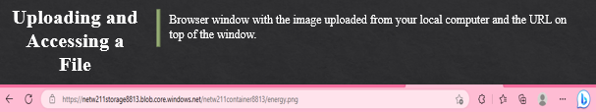
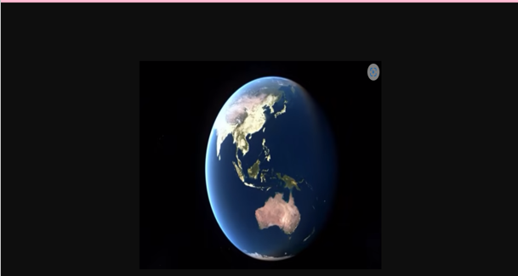

Slide 18
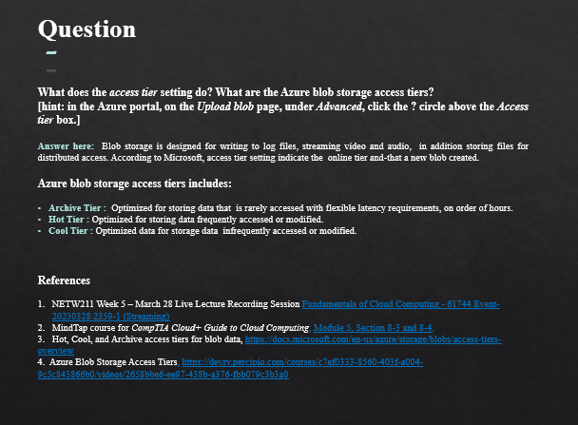

Slide 19


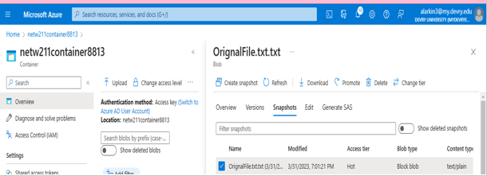

Slide 20
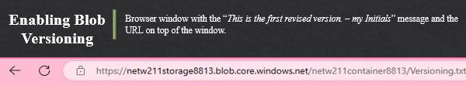




Slide 21
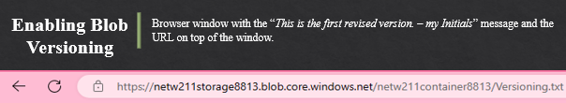




Slide 22
Module 6 Cloud Monitoring

Slide 23
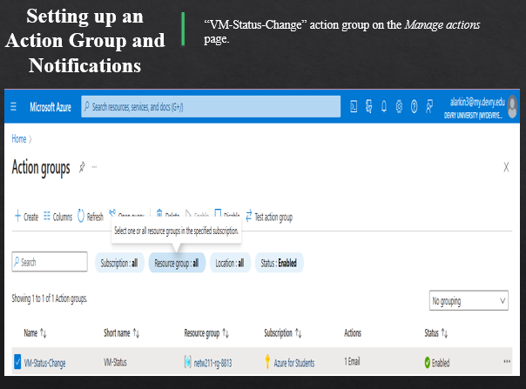

Slide 24
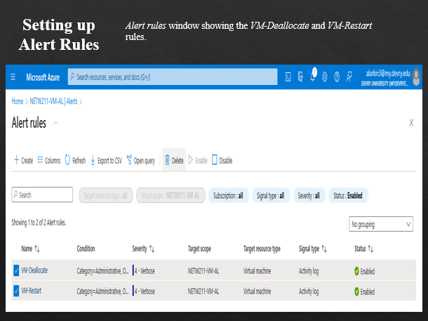

Slide 25
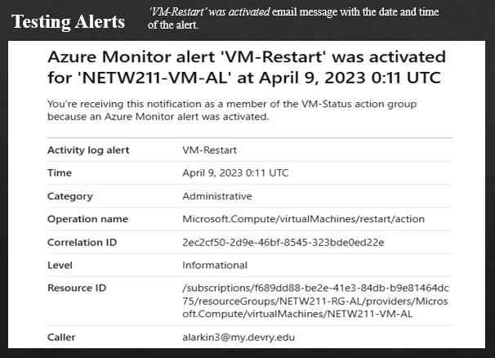

Slide 26
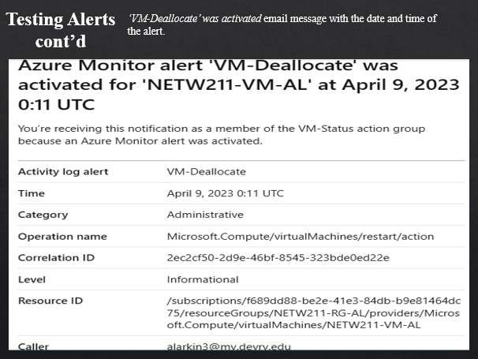

Slide 27
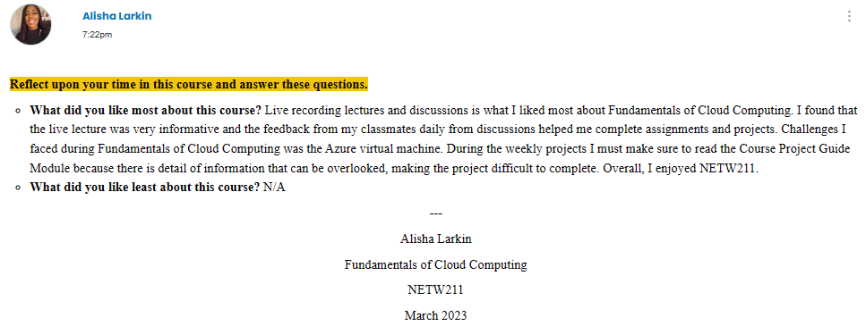
Challenges

Slide 28
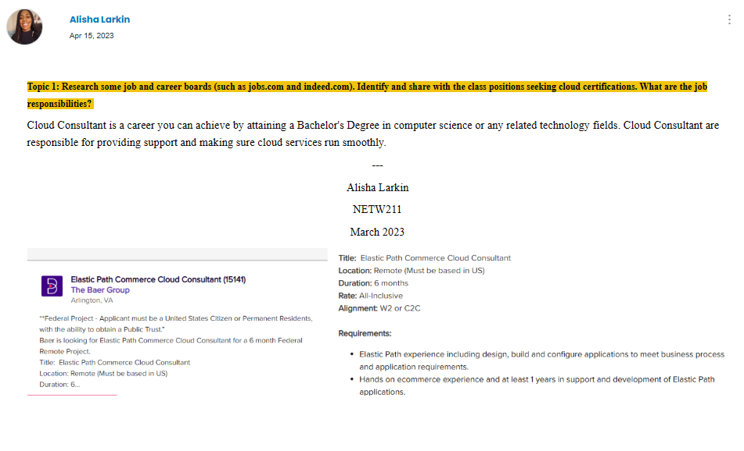
Technology Careers and Opportunity

Slide 29
Conclusion
Fundamentals of Cloud Computing (NETW211) course was intriguing. I analyze and test common cloud maintenance tools, services and techniques. Explain the virtualization of networking. In addition, explored cloud-centric access control techniques. ITPRO.TV offered topics that covered CompTIA Cloud+, Cloud Technology Skills, Networking Skills, and Certification Exam Practice. Professor Lynn Risley is amazing and provided the tools needed to complete NETW211, as well as keep students updated through his daily announcements. Thank you, Professor Lynn Risley, for making this experience at DeVry University one to remember!
---
Alisha T. Larkin

Slide 30
Alisha T. Larkin | Fundamentals of Cloud Computing | NETW211 | April 2023

