Slide 1


SEC285
DeVry University
Fundamentals of Information System Security
Larkin, Alisha
August 26, 2023
https://alishalarkin18.wixsite.com/alisha-larkin-devry

Slide 2
Introduction
Fundamentals of Information System Security (SEC285), educate students on devices, network, and data concerns in security related to our communities.
Learning objectives for SEC285 includes:
•Defend against attacks and handle challenges while securing data.
•Network technology security.
•Risk management.
SEC285 introduces ITPRO.TV, Live Virtual Machines Lab, and Cengage MindTap to implement teaching to enhance intelligence in security solutions in pursuit of seeking careers in the digitized world.

Slide 3
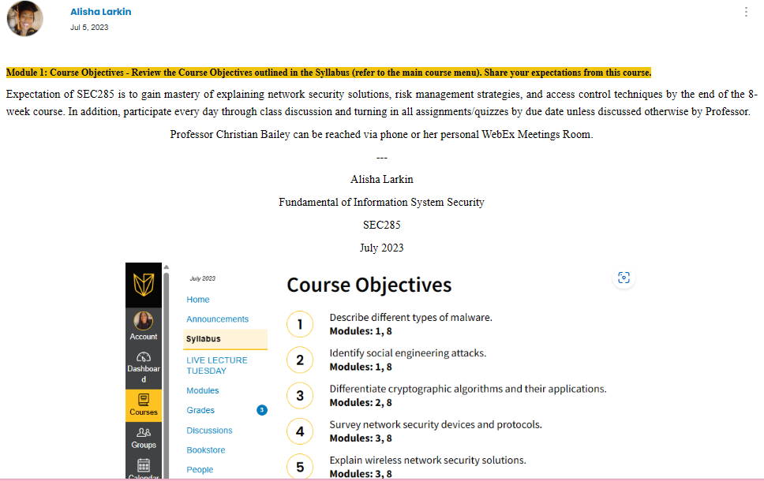

Slide 4
Module 2
Asymmetric Key Encryption

Slide 5
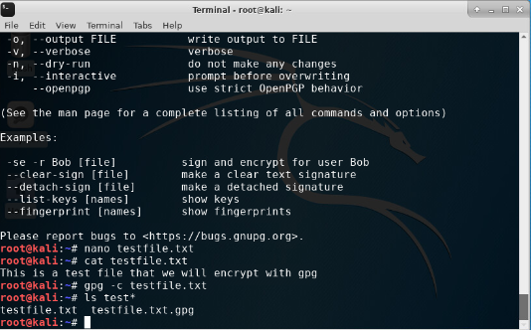
File Encryption |
Content of the plaintext file, content of the encrypted file.

Slide 6
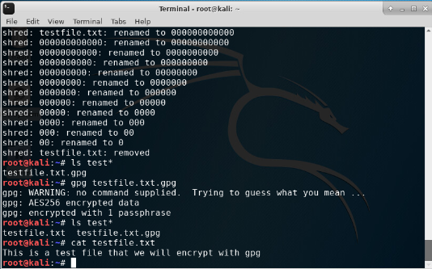
File Decryption |
The encrypted file being listed by itself. The decrypting process. Both the encrypted file and the original plaintext file being listed.

Slide 7
Module 3
Stateful Firewall

Slide 8
Question
What effect does the sudo iptables --policy INPUT DROP command have on the access to computing resources?
Answer: manages incoming and outcoming traffic making access to the computing systems.
References
✍️. (2022, August 30). YouTube. Retrieved July 23, 2023, from ttps://lms.devry.edu/lms/video/player.html?video=1_6f9wf7h3

Slide 9
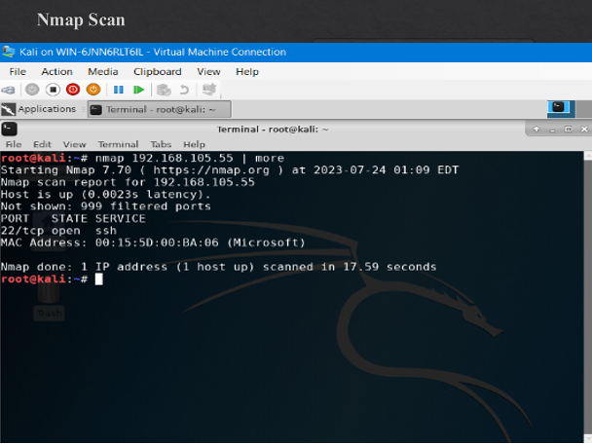

Slide 10
Module 4
Bring Your Own Device (BYOD) Security Policy

Slide 11
Overview:
In modern enterprises tablets, smartphones, and laptops are the essence in the way the digital world engage with IoT devices. Accelerometer are sensor used on tablets that identify movements , orientation, and vibration of the device and are proven to be extraordinary favored. One of the earliest portable computers is the laptop. Less processing power and like a desktop computer, laptop computer abilities are appealing. Smartphones has operating systems with many purposes like a standard computer. Enterprise deployment models e.g., cooperate-owned, bring your own device (BYOD), virtual desktop infrastructure (VDI), cooperate owned, personally enabled (COPE), and choose your own device (CYOD) has been accepted by many organizations to make employee more productive while working during traveling.
2. Purpose:
The purpose of the policy is to protect the security integrity of devices by implementing safety security measured to be followed by employees and staff. Increased employee performance, management flexibility, and less oversight makes BYOD, COPE, and CYOD a great option for employees to be proactive while away from the office. Risk factors are common among mobile devices. Three entities procedure are used to protect the confidentially, integrity, and availability (CIA) of information on devices which includes, products, people, and policies. IT security is essential in protecting data and devices from threat.

Slide 12
3. Scope:
Tablets rely on touchscreen due to the inaccessibility of a built-in keyboard. Laptops can be used on desks, a person's lap, and are easy to carry making this device a portable computer. Wi-Fi is commonly used with mobile devices to connect to remote networks. Risk associated with mobile devices includes location tracking, physical security, unauthorized recording, and limited firmware updates.
4. Policy:
Security risk presents concerns to mobile devices due to being stolen or lost making unprotected data available to thief. Creating a personal identification number (PIN), passwords, and fingerprint reader are great ways to protect the device prior to entry of the devices. Mobile device management (MDM), mobile application management (MAM), and mobile content management (MCM) are supportive tools that can governance the enterprise of mobile devices.
The goal of the employees and staff:
Secure mobile devices always.
Use support tools for mobile management.
Disable unused features.
Mange Encryption.
Traveling in high-risk area, keep mobile devices out of sight.
Secure applications on devices.
Screen lock device to prevent access.

Slide 13
5. Policy Compliance:
An employee and staff found to have violated this policy may be subject to disciplinary actions up to and including termination of employment.
6. Related Standards, Policies, and Processes:
Health Insurance Portability and Accountability Act (HIPAA) compliance is the protection, privacy, security of electronic health records. Review policy compliance for violation of standards, policies, and processes.

Slide 14
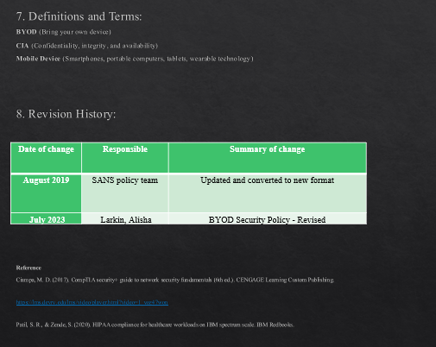

Slide 15
Module 5
Multifactor Authentication (MFA)

Slide 16
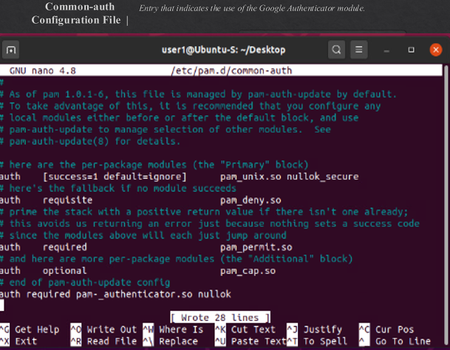

Slide 17
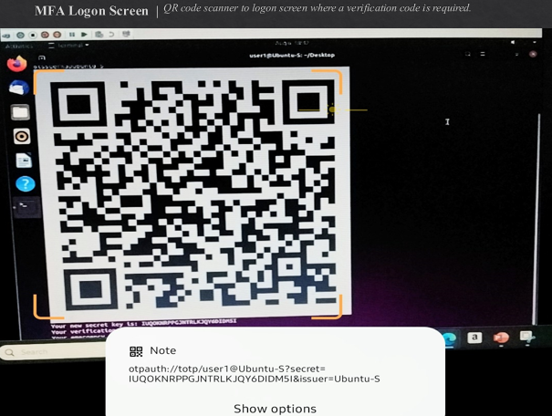

Slide 18
Module 6
Vulnerability Assessment

Slide 19
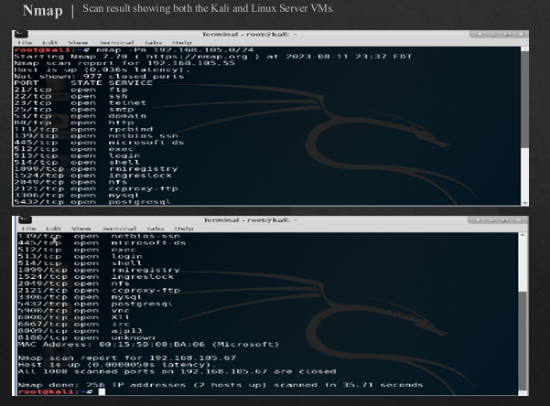

Slide 20
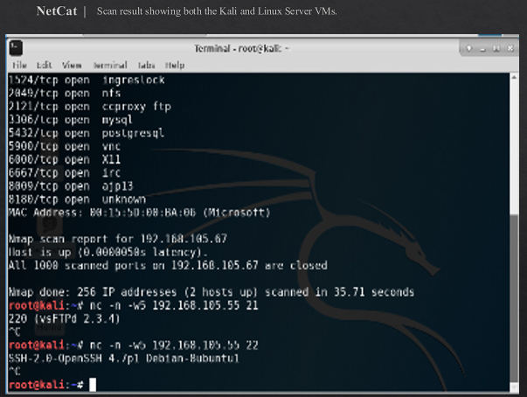

Slide 21
Challenges
Fundamentals of Information System Security (SEC285), I faced some challenges which included security terminology, e.g., banner grabbing, dumpster diving, bluejacking, jailbreaking, to name a few. Throughout the 8-week course, I’ve expanded awareness in understanding the importance of information system security and managing risk through risk assessment and training in reducing risk. In return, mastering security terminology and security threat preventions
---
Alisha T. Larkin
July 2023

Slide 22
Technology Careers
and
Opportunities
Fundamentals of Information System Security (SEC285), have prepared me for IT careers in cybersecurity. Joining CompTIA+ Associations is a great way to stay updated with current data pertaining to employment and training opportunities, as well as achieving a CompTIA+ Security certification.
---
Alisha Larkin
July 2023

Slide 23
Conclusion
Fundamentals of Information System Security (SEC285), was incredible. What I mastered most in SEC285 was gaining insight on how to effectively establish team goals by using feedback while demonstrating confidence, responsibility, and competency in information system security.
Professor Christina Bailey is a phenomenal expert in cyber security engineering.
Thank you for sharing your intelligence with SEC285.
It was an honor to be your student!
---
Alisha T. Larkin

Slide 24
Reference
✍️. (2022, August 30). YouTube. Retrieved July 23, 2023, from https://lms.devry.edu/lms/video/player.html?video=1_6f9wf7h3
Ciampa, M. D. (2017). CompTIA security+ guide to network security fundamentals (6th ed.). CENGAGE Learning Custom Publishing.
https://lms.devry.edu/lms/video/player.html?video=1_yoz47won
Patil, S. R., & Zende, S. (2020). HIPAA compliance for healthcare workloads on IBM spectrum scale. IBM Redbooks.

Slide 25
Alisha T. Larkin | Fundamentals of Information System Security | SEC285 | July 2023

